Slide 1

7COM1079-2022 Student Group No: A287
Names of Student Attendees : Taqi Hassan
Ravichandrareddy chitti
Talal Nasir
Michael Agyemang
Group Name: A 287 Name of Student Presenting:
R Q – Does the type of alcohol (beer, wine, or spirits) consumed have a stronger correlation with happiness levels?
Tutorial Presentation for Feedback

Slide 2
INTRODUCTION Background:
The dataset explores the relationship between happiness levels and alcohol consumption (beer, wine, and spirits) across various countries. It includes additional socio-economic indicators such as GDP per capita and Human Development Index (HDI), providing context for understanding the factors influencing happiness globally.
Purpose:
The purpose of this dataset is to analyze whether the type and amount of alcohol consumption are correlated with happiness levels. This can provide insights into lifestyle factors that contribute to happiness, helping researchers and policymakers understand broader patterns of well-being and cultural behavior.
7COM1079-2022 Student Group No: A 287 Names of Student Group Attendees: Taqi Hassan
Ravichandrareddy chitti
Talal Nasir
Michael Agyemang

Slide 3
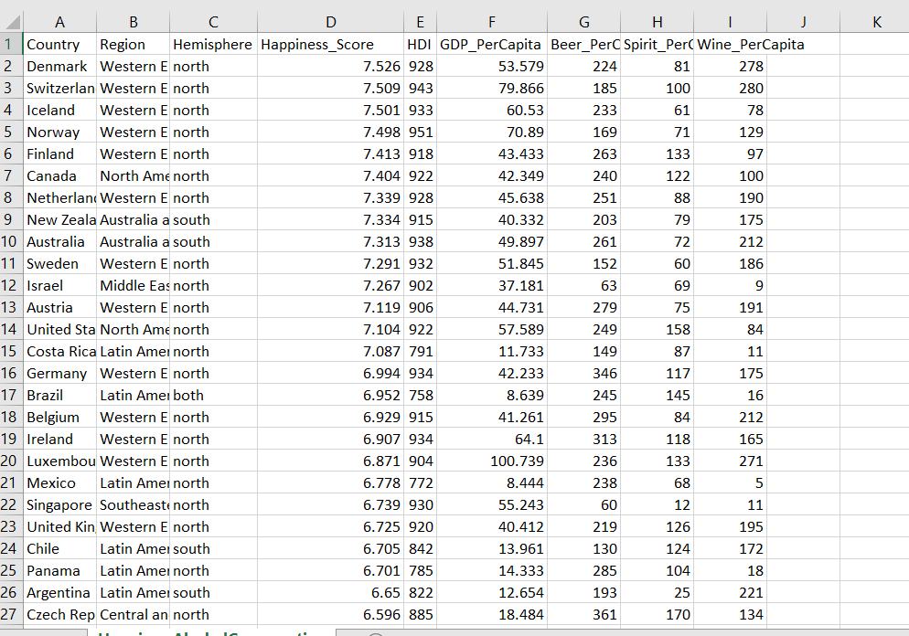
7COM1079-2022 Student Group No: A 287 Names of Student Group Attendees: Taqi Hassan
Ravichandrareddy chitti
Talal Nasir
Michael Agyemang
Dataset URL: https://www.kaggle.com/datasets/marcospessotto/happiness-and-alcohol-consumption?resource=download and DS254)
This dataset is interesting to us because : This dataset is interesting to us because it allows us to explore the relationship between alcohol consumption (beer, wine, and spirits) and happiness levels across different countries and regions.
No.of Rows and Columns: 122 and 9
Independent variable : Beer_PerCapita , Wine_PerCapita and Spirit_PerCapita (Interval Data) Dependent variable : Happiness_Score: (Interval Data)
Notes:
Before specifying your Research Question you must define the type of data you are analysing. Are the variables you select interval data (measurement data you can divide, multiple, etc), OR are they ordinal (there is a definite order but the intervals between each variable are not necessarily equal, or the terms might be subjective like in a likert scale); OR are they just categorical/nominal (Items such as film names, cities, etc., that you can count numbers of occurrences? You also need to understand whether the variable is either dependent or independent and this will vary according to the context. Independent variables may cause an effect, whereas the dependent variable might be effected by the independent variable. Check the lecture notes on the RQ for more information and examples.
You will get only one opportunity to present your Research Question ahead of the submission date. Have your questions ready, and be ready to take notes on feedback.
3

Slide 4
PRE 7COM1079-2022 Student Group No: A 287
3
Our Research Question is:Does the alcohol (Beer , Wine and Spirit) Consumed have a stronger corelation with happiness Levels?
Template ¹: Interval/Ordinal vs Interval/Ordinal: “Is there a correlation between [Happiness_Score][dependent interval variable] and Beer_PerCapita, Spirit_PerCapita, Wine_PerCapita [independent interval variable]”.
Notes:
4

Slide 5
7COM1079-2022 Student Group No: A 287
Null Hypothesis (H₀):
There is no significant correlation between alcohol consumption (beer, wine, or spirits) and happiness scores.
Mathematically:
H₀ (Beer): ρBeer=0
H₀ (Wine): ρWine=0
H₀ (Spirits): ρSpirits=0
Alternative Hypothesis (H₁):
There is a significant correlation between alcohol consumption (beer, wine, or spirits) and happiness scores.
Mathematically:
H₁ (Beer): ρBeer≠0
H₁ (Wine): ρWine≠0
H₁ (Spirits): ρSpirits≠0
4

Slide 6
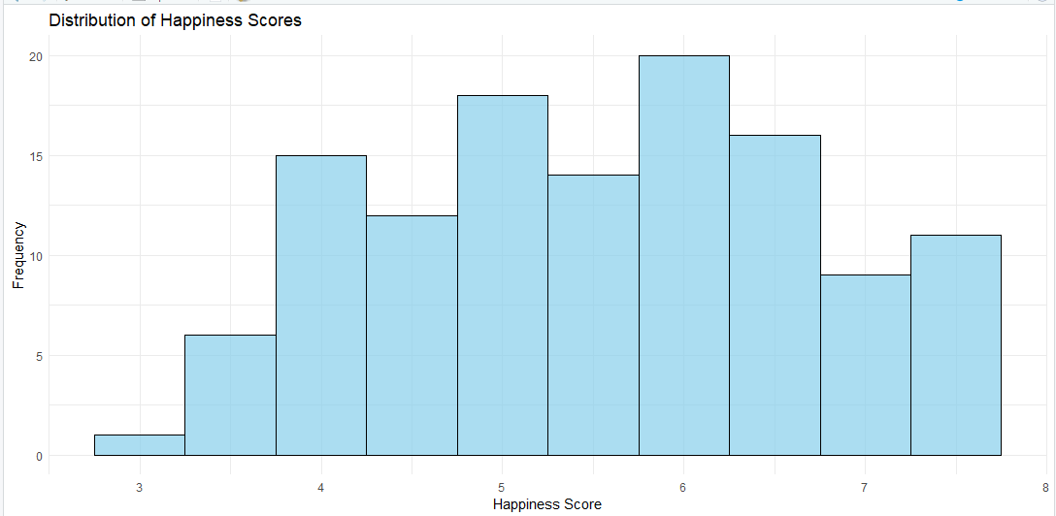
7COM1079-2022 Student Group No: A 287
Histogram –Distribution of Happiness_score
The histogram illustrates the distribution of Happiness Scores in the dataset. It shows:
Range of Scores: Happiness scores primarily fall between 3 and 8.
Frequency: The most frequent scores are concentrated around 4 to 6, indicating that most countries in the dataset have moderate happiness levels.
Skewness: The distribution appears fairly balanced, with no extreme skewness observed.

Slide 7
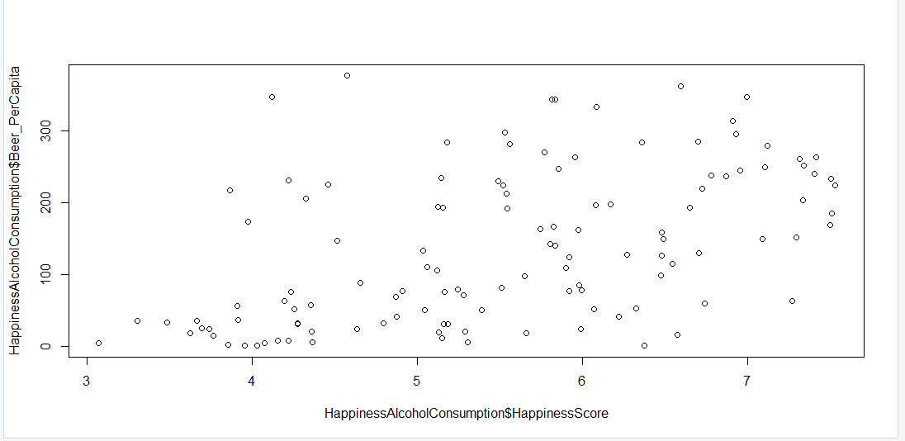
The scatter plot shows the relationship between Beer Consumption per Capita and Happiness Scores: Observation: The points are scattered without a clear linear pattern, suggesting that there might not be a strong correlation between beer consumption and happiness scores.
7COM1079-2022 Student Group No: A 287
Alcohol Beer Consumption Vs Happiness Scores
Happiness score

Slide 8
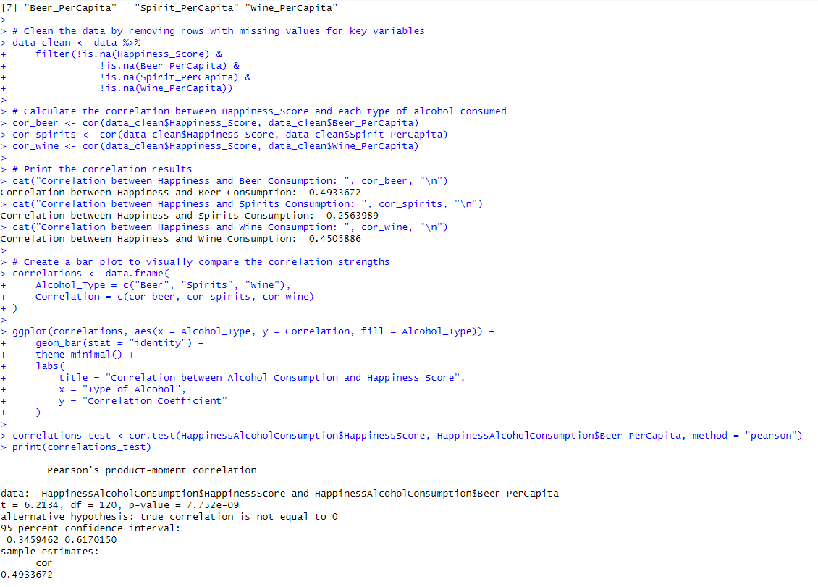
Statistical Analysis correlation Test Results: Correlation Coefficient (r):0.4933 P-value: < 7.752e—09 Interpretation:The correlation analysis indicates that beer and wine consumption have a moderate positive correlation with happiness scores, while spirits consumption shows a weak, non-significant correlation
7COM1079-2022 Student Group No: A 287

Slide 9
7COM1079-2022 Student Group No: A 287
Conclusion
Summary: Beer and wine consumption show moderate positive correlations with happiness scores, while spirits consumption has a weak and insignificant correlation, suggesting varying impacts of alcohol types on happiness.
Implications: The findings imply that alcohol consumption may influence happiness, but further research is required to understand the complex factors beyond alcohol consumption that affect well-being.

